Slide 1


NetCore:
A network propagation approach using node core
Gal Barel
Computational Molecular Biology
Seminar
15.10.2020

Slide 2
Overview
What is network propagation
Random Walk with Restart formulation
Current problems with existing methods
PPI degree bias
Module identification
Results
GWAS
Cardiotoxicity – HeCaToS
Feature selection for drug sensitivity prediction
Future directions
NetCore for Proteomics

Slide 3
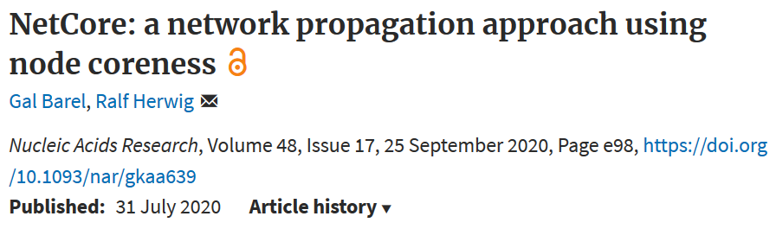
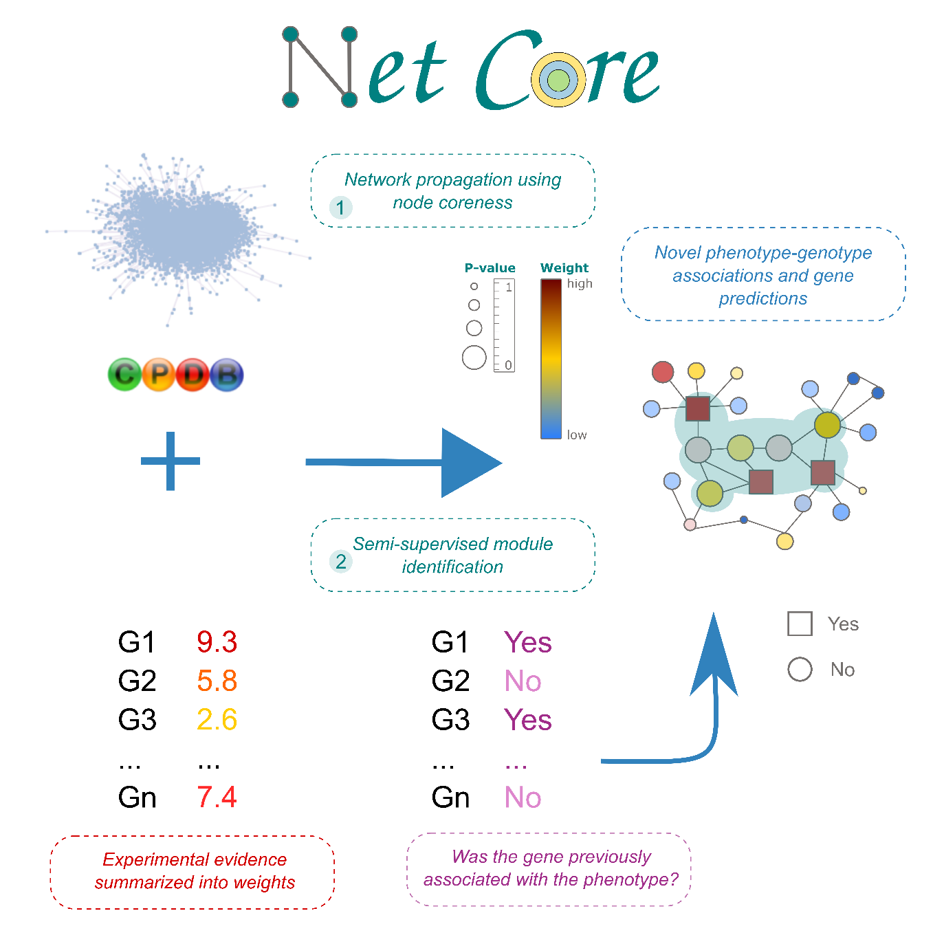
https://github.molgen.mpg.de/barel/NetCore

Slide 4

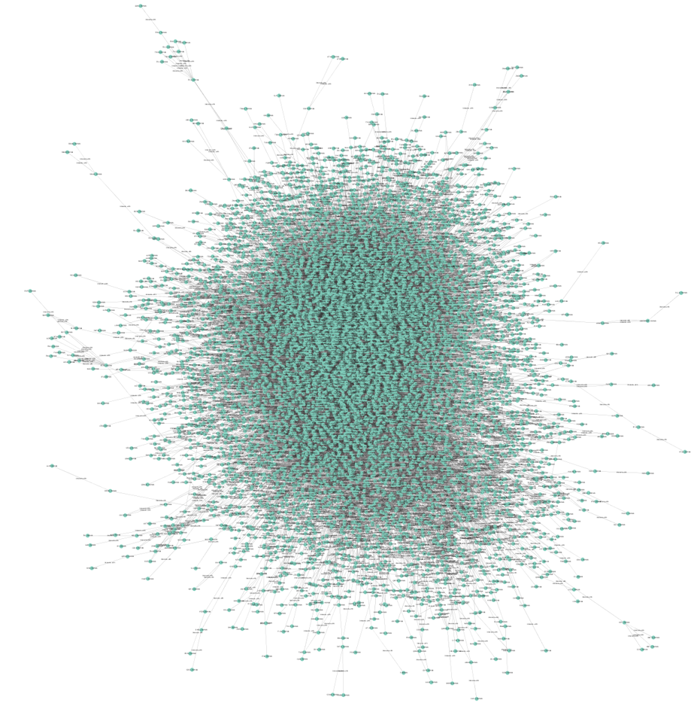
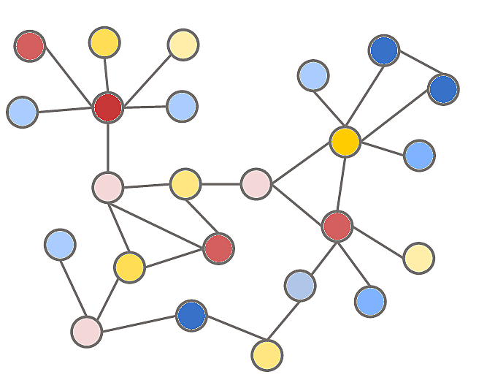
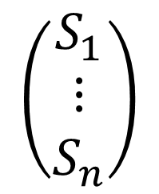
Network based modelling
Network Propagation
$$\left(\begin{matrix}S_{1} \\ ⋮ \\ S_{n}\end{matrix}\right)$$
Node re-ranking
Network modules

Slide 5

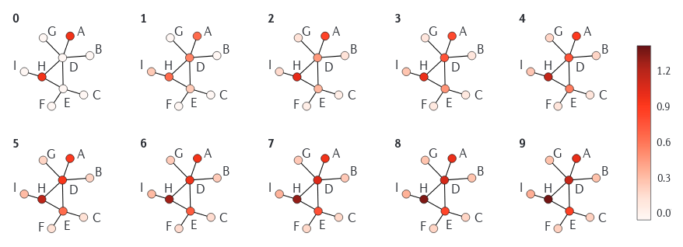
Network Propagation
Cowen et al. (2017) . Nature Reviews Genetics.
Notes:
What is network propagation
Random walk process
Equivalent to a markov chain
Need to mention the differences: random walk, random walk with restart and diffusion kernel

Slide 6
Network based modelling
Network Propagation
$$\left(\begin{matrix}S_{1} \\ ⋮ \\ S_{n}\end{matrix}\right)$$

Slide 7
Network based modelling
Network Propagation
$$\left(\begin{matrix}S_{1} \\ ⋮ \\ S_{n}\end{matrix}\right)$$

Slide 8
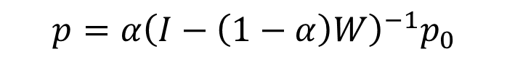
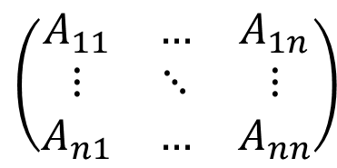
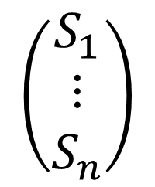
Network Propagation
Random Walk (with restart)
$$\left(\begin{matrix}A_{11} & … & A_{1n} \\ ⋮ & ⋱ & ⋮ \\ A_{n1} & … & A_{nn}\end{matrix}\right)$$
$$p=α{\left(I−\left(1−α\right)W\right)}^{−1}p_{0}$$
$$\left(\begin{matrix}S_{1} \\ ⋮ \\ S_{n}\end{matrix}\right)$$
Notes:
What is network propagation

Slide 9
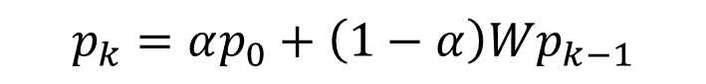
Network Propagation
Random Walk (with restart)
$$p_{k}=αp_{0}+\left(1−α\right)Wp_{k−1}$$
Notes:
In a common version of the random walk with restart, a random walker traverses the graph in a series of discrete steps, transitioning to one of its neighbors at each step with probability β and returning to its initial position with probability 1−β⁠, leading to a non-trivial stationary distribution. We use this stationary distribution to define the following similarity matrix.
9

Slide 10
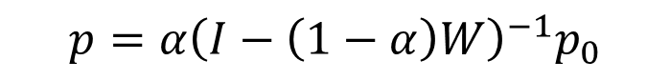
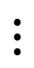
Network Propagation
Random Walk (with restart)
$$p_{k}=αp_{0}+\left(1−α\right)Wp_{k−1}$$
$$⋮$$
$$p=α{\left(I−\left(1−α\right)W\right)}^{−1}p_{0}$$
Notes:
In a common version of the random walk with restart, a random walker traverses the graph in a series of discrete steps, transitioning to one of its neighbors at each step with probability β and returning to its initial position with probability 1−β⁠, leading to a non-trivial stationary distribution. We use this stationary distribution to define the following similarity matrix.
10

Slide 11
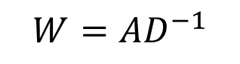
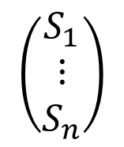
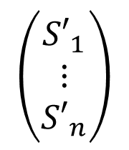
Network Propagation
Random Walk (with restart)
$$p_{k}=αp_{0}+\left(1−α\right)Wp_{k−1}$$
$$⋮$$
$$p=α{\left(I−\left(1−α\right)W\right)}^{−1}p_{0}$$
$$\left(\begin{matrix}{S′}_{1} \\ ⋮ \\ {S′}_{n}\end{matrix}\right)$$
$$\left(\begin{matrix}S_{1} \\ ⋮ \\ S_{n}\end{matrix}\right)$$
$$W=AD^{−1}$$
Notes:
In a common version of the random walk with restart, a random walker traverses the graph in a series of discrete steps, transitioning to one of its neighbors at each step with probability β and returning to its initial position with probability 1−β⁠, leading to a non-trivial stationary distribution. We use this stationary distribution to define the following similarity matrix.
11

Slide 12
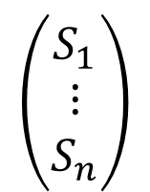
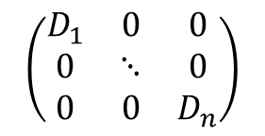
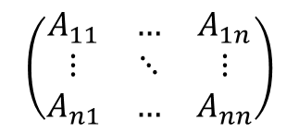
Network Propagation
Random Walk (with restart)
$$p_{k}=αp_{0}+\left(1−α\right)Wp_{k−1}$$
$$⋮$$
$$p=α{\left(I−\left(1−α\right)W\right)}^{−1}p_{0}$$
$$\left(\begin{matrix}{S′}_{1} \\ ⋮ \\ {S′}_{n}\end{matrix}\right)$$
$$\left(\begin{matrix}S_{1} \\ ⋮ \\ S_{n}\end{matrix}\right)$$
$$W=AD^{−1}$$
$$\left(\begin{matrix}A_{11} & … & A_{1n} \\ ⋮ & ⋱ & ⋮ \\ A_{n1} & … & A_{nn}\end{matrix}\right)$$
$$\left(\begin{matrix}D_{1} & 0 & 0 \\ 0 & ⋱ & 0 \\ 0 & 0 & D_{n}\end{matrix}\right)$$
Notes:
In a common version of the random walk with restart, a random walker traverses the graph in a series of discrete steps, transitioning to one of its neighbors at each step with probability β and returning to its initial position with probability 1−β⁠, leading to a non-trivial stationary distribution. We use this stationary distribution to define the following similarity matrix.
12

Slide 13
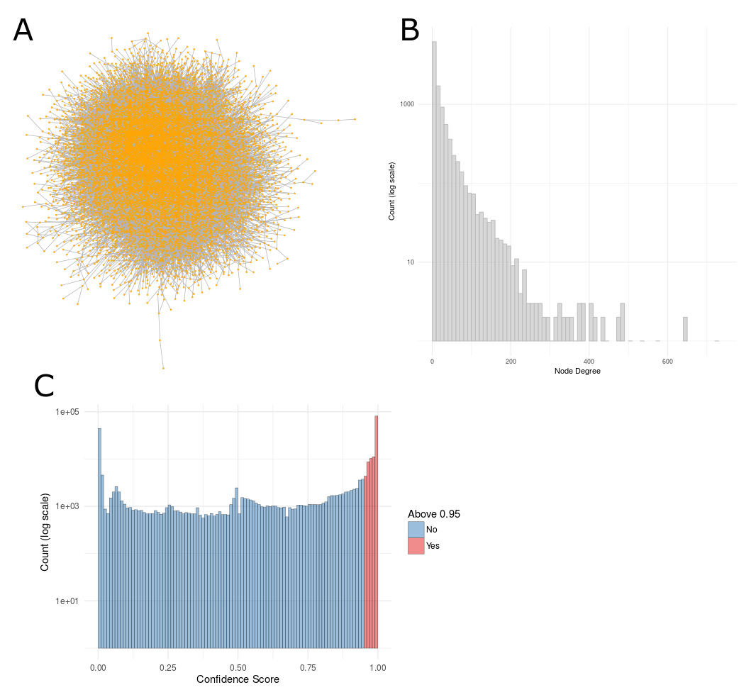
PPI Network Degree Bias
Notes:
PPI networks have a power law degree distribution

Slide 14
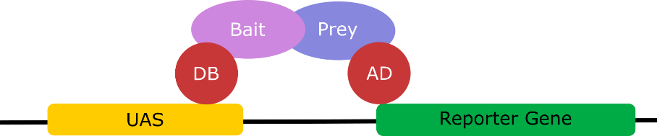
PPI Network Degree Bias
Yeast two hybrid
Notes:
The premise behind the test is the activation of downstream reporter gene(s) by the binding of a transcription factor onto an upstream activating sequence (UAS).
the transcription factor is split into two separate fragments, called the DNA-binding domain (DBD or often also abbreviated as BD) and activating domain (AD).
The BD is the domain responsible for binding to the UAS and the AD is the domain responsible for the activation of transcription
Two fusion proteins are prepared: BD+Bait and AD+Prey. Neither of them are usually sufficient to initiate transcription (of the reporter gene) alone.
When both fusion proteins are produced and the Bait part of the first fusion protein interacts with the Prey part of the second, transcription of the reporter gene occurs.

Slide 15
PPI Network Degree Bias
Experimental Bias
“star-like” structures of bait proteins
Annotation Bias
Well studies proteins are used more often as bait
Yeast two hybrid
Notes:
The premise behind the test is the activation of downstream reporter gene(s) by the binding of a transcription factor onto an upstream activating sequence (UAS).
the transcription factor is split into two separate fragments, called the DNA-binding domain (DBD or often also abbreviated as BD) and activating domain (AD).
The BD is the domain responsible for binding to the UAS and the AD is the domain responsible for the activation of transcription
Two fusion proteins are prepared: BD+Bait and AD+Prey. Neither of them are usually sufficient to initiate transcription (of the reporter gene) alone.
When both fusion proteins are produced and the Bait part of the first fusion protein interacts with the Prey part of the second, transcription of the reporter gene occurs.

Slide 16
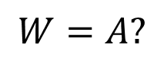
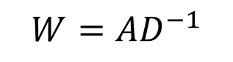
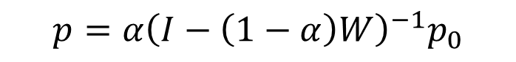
PPI Network Degree Bias
$$p=α{\left(I−\left(1−α\right)W\right)}^{−1}p_{0}$$
$$W=A?$$
$$W=AD^{−1}$$
Notes:
When using the degree to get the walking probabilities nodes with a high degree will be visited more often
Therefore the results of the propagation will also be biased with high degree nodes

Slide 17
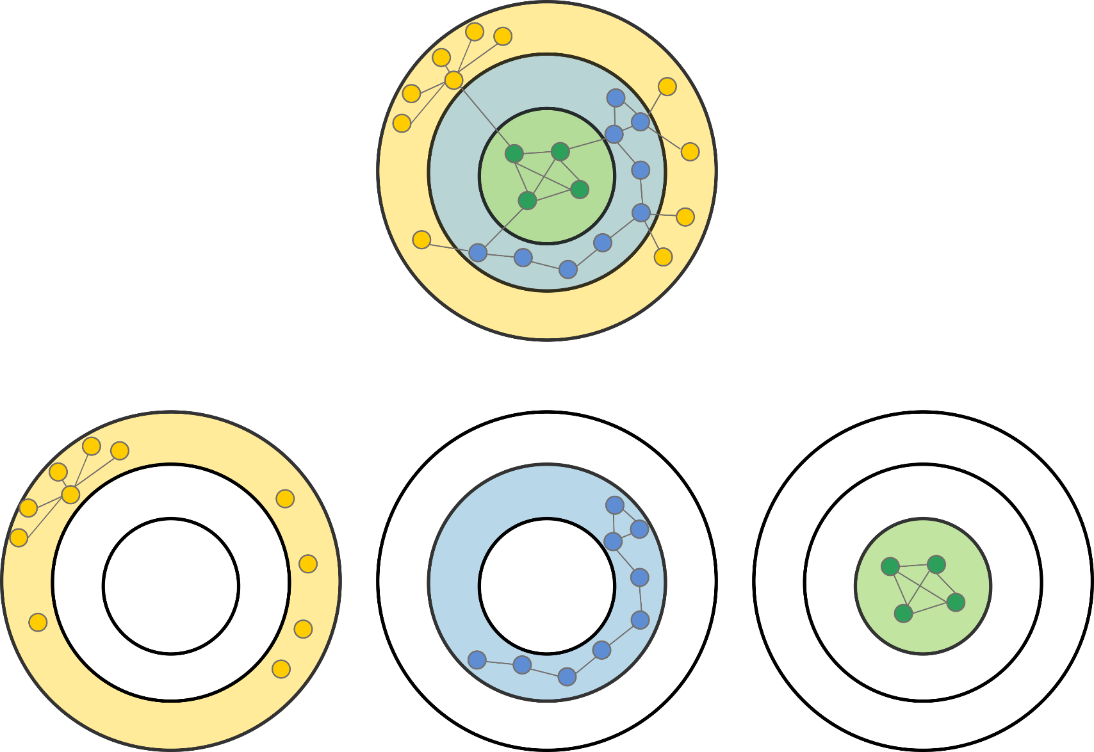
Node core

Slide 18
Core decomposition
K=1
K=2
K=3

Slide 19
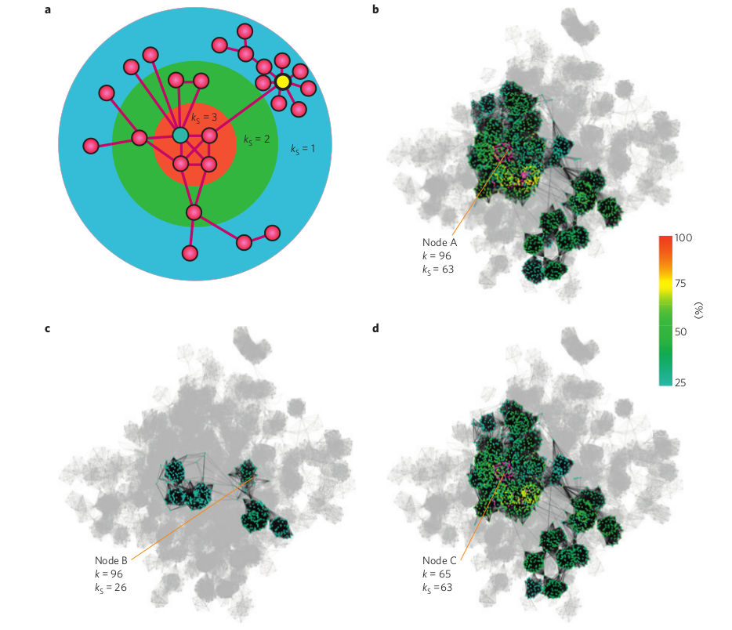
Core indicates the spread in the network
Identification of influential spreaders in complex networks . Kitsak et al. (2010). Nature Physics.
Notes:
The location of the node is more significant than the number of its neighbours
Coreness is a better indicator of a node’s influence on spreading dynamics in the network

Slide 20
Node degree vs node core
Degree = 4
Core = 1
Degree = 4
Core = 3

Slide 21
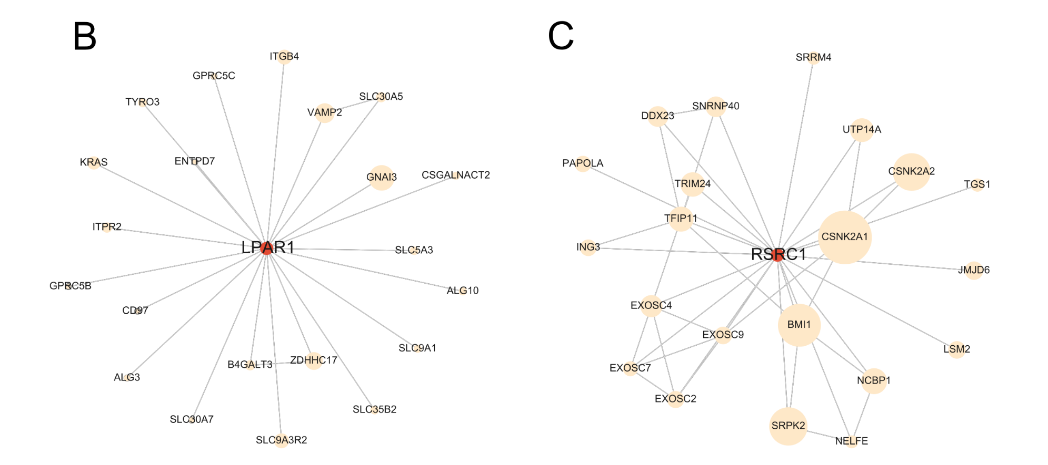
Node degree vs node core
Degree = 21
Core = 8
Degree = 21
Core = 18

Slide 22
Network Propagation
Random Walk (with restart)
$$p_{k}=αp_{0}+\left(1−α\right)Wp_{k−1}$$
$$⋮$$
$$p=α{\left(I−\left(1−α\right)W\right)}^{−1}p_{0}$$
$$\left(\begin{matrix}{S′}_{1} \\ ⋮ \\ {S′}_{n}\end{matrix}\right)$$
$$\left(\begin{matrix}S_{1} \\ ⋮ \\ S_{n}\end{matrix}\right)$$
$$W=AD^{−1}$$
Core
$$\left(\begin{matrix}A_{11} & … & A_{1n} \\ ⋮ & ⋱ & ⋮ \\ A_{n1} & … & A_{nn}\end{matrix}\right)$$
$$\left(\begin{matrix}D_{1} & 0 & 0 \\ 0 & ⋱ & 0 \\ 0 & 0 & D_{n}\end{matrix}\right)$$
Notes:
In a common version of the random walk with restart, a random walker traverses the graph in a series of discrete steps, transitioning to one of its neighbors at each step with probability β and returning to its initial position with probability 1−β⁠, leading to a non-trivial stationary distribution. We use this stationary distribution to define the following similarity matrix.
22

Slide 23



Normalization of the Adjacency Matrix
degree

Slide 24
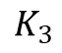
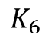
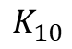
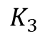
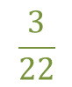
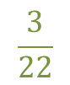
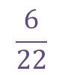
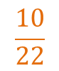
Normalization of the Adjacency Matrix
degree
core
$$\frac{3}{22}$$
$$\frac{6}{22}$$
$$\frac{10}{22}$$
$$\frac{3}{22}$$

Slide 25
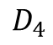
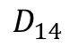
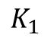
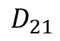
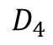
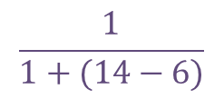
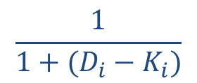

Normalization of the Adjacency Matrix
degree
core
$$\frac{3}{22}$$
$$\frac{6}{22}$$
$$\frac{10}{22}$$
$$\frac{3}{22}$$
degree-core difference
$$\frac{1}{1+(D_{i}−K_{i})}$$
$$×$$
$$\frac{1}{1+(14−6)}$$
Notes:
Degree-crore difference:
If the difference between the degree and the k-shell is very high, then we multiply the probability by that, and therefore it will be lower
When the difference between the degree and the k-shell is very high than it means there is a degree bias

Slide 26
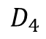
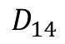
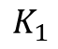
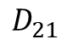
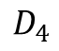
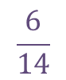
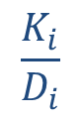

Normalization of the Adjacency Matrix
degree
core
$$\frac{3}{22}$$
$$\frac{6}{22}$$
$$\frac{10}{22}$$
$$\frac{3}{22}$$
degree-core difference
degree-core ratio
$$\frac{1}{1+(D_{i}−K_{i})}$$
$$\frac{K_{i}}{D_{i}}$$
$$\frac{6}{14}$$
$$\frac{1}{1+(14−6)}$$
$$×$$
$$×$$
Notes:
Degree-core ratio:
Another way to normalized the probability that is based on degree only, but in this case the penalty is the ratio (which is higher than the difference, so the probability doesn’t decrease as much)

Slide 27


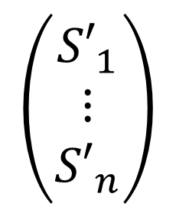

Adjacency Matrix Normalization - Evaluation
$$p=α{\left(I−\left(1−α\right)W\right)}^{−1}p_{0}$$
$$W=A_{N}$$
$$\left(\begin{matrix}{S′}_{1} \\ ⋮ \\ {S′}_{n}\end{matrix}\right)$$
Network Propagation with core normalizations
$$\left(\begin{matrix}S_{1} \\ ⋮ \\ S_{n}\end{matrix}\right)$$
Notes:
Scheme of the method:
Applied to all the different normalizations
5-fold cross validation
P-value by network randomizations

Slide 28
GWAS gene sets
GWAS Catalog
5-fold cross validations
Significance level via network permutations test
Disease / Trait | Genes
Body mass index | 97
Breast cancer | 73
Crohn’s disease | 227
Height | 234
Prostate cancer | 168
Rheumatoid arthritis | 88
Schizophrenia | 226
Systemic lupus erythematosus | 90
Type 2 diabetes | 78
Ulcerative colitis | 203
Vitiligo | 76
Notes:
Each fold split into training and testing set (1:4)
Binary prediction : is the gene associated with the disease?

Slide 29
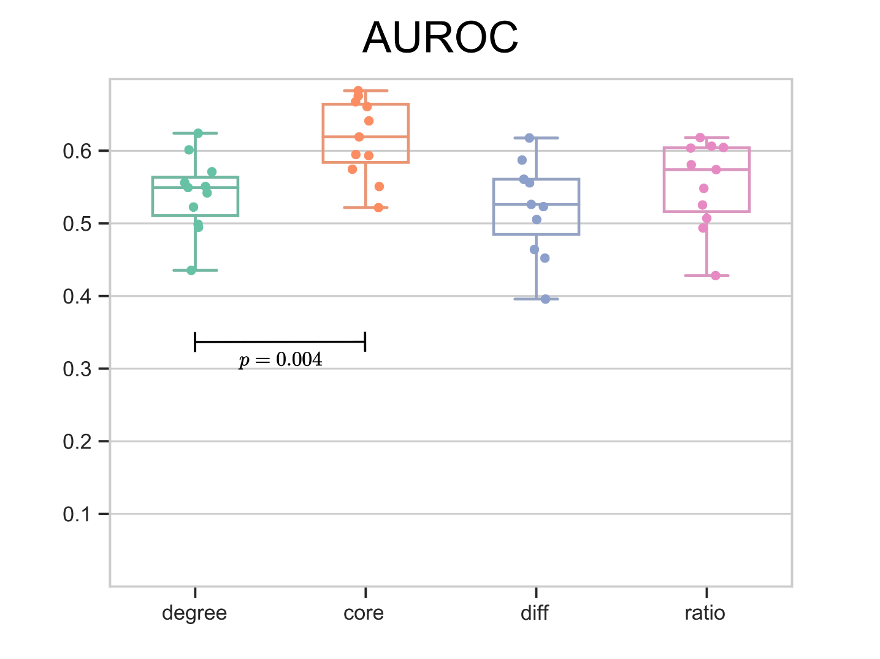
Results – GWAS
Notes:
AUROC for 11 GWAS disease/traits
Number of genes for each set: between 100-400

Slide 30
NetCore - Network propagation using core
NetCore
$$\left(\begin{matrix}S_{1} \\ ⋮ \\ S_{n}\end{matrix}\right)$$
Node re-ranking
Network modules

Slide 31
Module identification for network propagation
NAGA (Carlin et al. 2019)
HotNet2 (Leiserson et al. 2015)
Hierarchical HotNet (Reyna et al. 2018)
Cowen et al. (2017) . Nature Reviews Genetics.
Notes:
Methods and problems:
NAGA (Carlin et al. 2019) – top 100 genes after propagation + sub-network clustering
No significance test
Arbitrary number of genes
HotNet2 (Leiserson et al. 2015) – strongly connected components after propagation
Estimated threshold usually creates very small modules
Hierarchical HotNet (Reyna et al. 2018) – hierarchical clusters
Both methods can potentially generate edges that are not in the original PPI network

Slide 32






Module Identification – with seed nodes
$$p<p_{max}$$
$$w<w_{min}$$
$$\left(\begin{matrix}S_{1} \\ ⋮ \\ S_{n}\end{matrix}\right)$$
$$\left(\begin{matrix}G_{1} \\ ⋮ \\ G_{m}\end{matrix}\right)$$

Slide 33
Module identification - Evaluation
Network Propagation with core normalization
$$\left(\begin{matrix}S_{1} \\ ⋮ \\ S_{n}\end{matrix}\right)$$
Module identification with seed nodes
Notes:
Scheme of the method:
Applied to all the different normalizations
5-fold cross validation
P-value by network randomizations

Slide 34
Results – GWAS
Type 2 Diabetes
Notes:
78 nodes
14 edges
Largest component of 5

Slide 35

Results – GWAS
Type 2 Diabetes
Seed Induced Sub-network
Notes:
78 nodes
14 edges
Largest component of 5

Slide 36

Results – GWAS
Type 2 Diabetes
Extended Seed Sub-network
Notes:
Additional 39 nodes
Additional 78 edges
15 components, largest of 53 nodes

Slide 37

Results – GWAS
Type 2 Diabetes
Largest Module
Notes:
Consists of 53 nodes, out of those 32 are from the input GWAS seed set and 21 are not, with a total of 64 edges.

Slide 38

NetCore - Network propagation using core
Input
Network propagation with core
Module identification with seed nodes

Slide 39
NetCore - applications
Schizophrenia
GWAS data
Cancer
Mutation data
Drug toxicity – HeCaToS
Gene expression data
Drug sensitivity prediction
Drug target feature selection

Slide 40
NetCore - applications
Schizophrenia
GWAS data
Cancer
Mutation data
Drug toxicity – HeCaToS
Gene expression data
Drug sensitivity prediction
Drug target feature selection

Slide 41




Cardiotoxicity – experimental design
3D cardiac
microtissues
Doxorubicin
Epirubicin
Idarubicin
Daunorubicin
PBPK dose modelling
AC treatment
(2 doses, 7 time points)
Methylome
Transcriptome
Proteome
Cell identity
Transcript. regulation
Dynamic analysis of time-series
PPI network construction
Data integration
Network propagation
ACT response network
Network integration and modelling of dynamic drug responses at multi-omics levels. Selevsek et al. (in press). Communications biology.
Notes:
Supplementary Figure 1 Study schema. 3D cardiac microtissues are grown and treated over a time period of 14 days with four anthracycline drugs. PBPK modelling is used to infer in vivo drug exposure levels at two doses (therapeutic and toxic doses). Omics measurements were done at seven different time points (2h, 8h, 24h, 72h, 168h, 240h, 336h). Methylome measurements were used to characterize cell identity of cardiac microtissues and to infer effects of AC treatment on transcriptional regulation. Proteome and transcriptome measurements were used to characterize dynamic cellular responses. Time series data was mapped to a large PPI network in order to integrate the data and to identify a common ACT response network across the treatments. The in vitro infered ACT response network was then tested for clinical relevance in cardiomyopathy patient biopsies and for physiological relevance on ATP production with sensitivity analysis using an established computational model of the human mitochondrion.

Slide 42


Cardiotoxicity – experimental design
3D cardiac
microtissues
Doxorubicin
Epirubicin
Idarubicin
Daunorubicin
AC treatment
(2 doses, 7 time points)
Methylome
Transcriptome
Proteome
Weighted FC for every:
drug, dose, time
PPI network construction
NetCore for every:
drug, dose
ACT response network

Slide 43



Results - Cardiotoxicity
Cardiomyopathy
The DisGeNET knowledge platform for disease genomics: 2019 update. Piñero et al. (2019). Nucleic acids research.
Notes:
Cardiomyopathy is a group of diseases that affect the heart muscle
disease-gene associations from the DisGeNET database for Cardiomyopathy (Familial Idiopathic). This included a list of 773 disease genes, 602 of them were covered in the CPDB PPI network

Slide 44
Results - Cardiotoxicity

Slide 45
Results - Cardiotoxicity

Slide 46




Results - Cardiotoxicity
Notes:
three KEGG [146] cardiomyopathy pathways: 1) dilated cardiomyopathy, 2) arrhythmogenic right ventricular cardiomyopathy (ARVC), and 3) hypertrophic cardiomyopathy (HCM). The pathways are comprised of 89, 72 and 83 genes respectively, with a total of 115 genes combined, and 106 of those were covered in the CPDB PPI network

Slide 47







ML-MED
Input
Feature selection
Methods
Output
Gene expression
Protein expression
CNV
SNPs
Methylation
Drug response curves
IC50
Drug Ligand binding
Tumor volume
CNN
Multiple kernels
Neural networks
Statistical learning
Regularization
Structure
Chemical properties
Physical properties
Drug targets
Background knowledge
Literature mining
Protein-protein (e.g. pathways)
Drug-drug (e.g. CMap)
Drug-protein (e.g. ChEMBL)
Notes:
Prediction of drug response for a given cellular system (cell line, patient)
Identification of testable, predictive features
Allows optimal therapy selection for patients
Allows stratifying patient samples for drug development
prediction of cancer therapy success in precision medicine
The goal of the project is to learn the sensitivity of the drug response of a biological system (cell line, patient tumors) from its molecular features and their relationships.

Slide 48

Prediction of drug sensitivity
IC50 = half maximal inhibitory concentration
https://docs.thunor.net/dose-response-parameters
Notes:
IC₅₀ is a quantitative measure that indicates how much of a particular inhibitory substance (e.g. drug) is needed to inhibit, in vitro, a given biological process or biological component by 50%
Half-maximal inhibitory concentration (IC₅₀) is a measure of drug potency expressed in molar units (M).
Motivation:
the response to anticancer therapy is highly dependent on the tumor genomic and transcriptomic makeup, resulting in heterogeneity in patient clinical response to anticancer drugs
gene expression data has been shown to be more predictive of drug sensitivity than genomics (i.e., copy number variation and mutations) or epigenomics (i.e., methylation)

Slide 49

Prediction of drug sensitivity
IC50 = half maximal inhibitory concentration
https://docs.thunor.net/dose-response-parameters
Notes:
IC₅₀ is a quantitative measure that indicates how much of a particular inhibitory substance (e.g. drug) is needed to inhibit, in vitro, a given biological process or biological component by 50%
Half-maximal inhibitory concentration (IC₅₀) is a measure of drug potency expressed in molar units (M).
Motivation:
the response to anticancer therapy is highly dependent on the tumor genomic and transcriptomic makeup, resulting in heterogeneity in patient clinical response to anticancer drugs
gene expression data has been shown to be more predictive of drug sensitivity than genomics (i.e., copy number variation and mutations) or epigenomics (i.e., methylation)

Slide 50

Prediction of drug sensitivity
IC50 = half maximal inhibitory concentration
https://docs.thunor.net/dose-response-parameters
Doxorubicin - BRCA
Notes:
IC₅₀ is a quantitative measure that indicates how much of a particular inhibitory substance (e.g. drug) is needed to inhibit, in vitro, a given biological process or biological component by 50%
Half-maximal inhibitory concentration (IC₅₀) is a measure of drug potency expressed in molar units (M).
Motivation:
the response to anticancer therapy is highly dependent on the tumor genomic and transcriptomic makeup, resulting in heterogeneity in patient clinical response to anticancer drugs
gene expression data has been shown to be more predictive of drug sensitivity than genomics (i.e., copy number variation and mutations) or epigenomics (i.e., methylation)

Slide 51

Multi-modal prediction of IC50 drug sensitivity
PaccMann: Prediction of anticancer compound sensitivity with multi-modal attention-based neural networks
Oskooei et al. (2019). arXiv.
Notes:
Three key data modalities that influence anticancer drug sensitivity: biomolecular measurements of cancer cells (gene expression, copy number alteration etc.), a network of known interactions between the biomolecular entities and the chemical structure of the anticancer compounds.
Gene expression levels of the cell lines were measured using microarrays. (This is basal transcriptional data and NOT transcription upon drug treatment)
STRING protein-protein interaction (PPI) network [18] was used to incorporate intracellular interactions in our model.
Network propagation was employed to reduce the dimensionality of the cell lines’ transcriptomic profile, consisting of 16,000 genes, to a smaller subset containing the most informative genes.
first assign a high weight (W = 1) to the reported drug target genes while assigning a very small positive weight (W = 1e-5).
Run network propagation for each drug and then: used the resultant weights distribution to determine the top 20 highly ranked genes for each drug.
We then pooled the top 20 genes for all 208 compounds, resulting in a subset of 2,128 genes. This subset containing the most informative genes was then used to profile each cell line in the dataset before it was fed into our models.

Slide 52
Feature selection with NetCore
Drug targets
GDSC
NetCore
Top 30 genes from each drug
Gene expression
2,063 genes from all drugs
Literature mining (MicroDiscovey)
Kernalized ranked learning (KRL)
Prediction
Kernelized rank learning for personalized drug recommendation. He et al. (2018). Bioinformatics.
Notes:
Run network propagation for each drug
Get the drug-targets from:
GDSC
Literature mining
Get top 20 (30) genes
Pool genes from all drugs together -> ~2,000 genes
Use only gene expression for the pooled genes
KRL – the goal is to rank the drugs based on their efficiency, such that the most efficient one is ranked the highest. The DO NOT predict the exact IC50 value.

Slide 53

KRL – 5 fold cross validations
Notes:
the results (5-fold) for the KRL baseline on the complete GDSC dataset for the different gene features used
Precision@k measures what fraction of the k most effective drugs (e.g., measured by IC50) are among the top k predicted drugs (i.e., the drugs on the top k ranks)
Precision@k which measures precision between the k highest-ranked recommendations and the k most effective drugs
Precision@5=0.4 means that out of five most effective drugs two were among the top five recommendations

Slide 54

PaccMann – 5 fold cross validations
Notes:
paccmann ndcg is trained using the ranking loss ndcg and paccmann mse is the model trained to directly predict the ic50 (not the ranking, like in the orig. paccmann paper)
mse: mean squared error ndcg: normalized discounted cumulative gain
DCG@k evaluates how well the order of the top k recommendations agrees with the order of the most effective drugs
NDCG@k : The gains are maximized when the most effective k drugs are the top k recommended drugs, ranked in the correct order.
NDCG@k ranges from 0 to 1

Slide 55
Summary and Outlook
NetCore – Network Propagation with core
Core normalization improves disease genes predictions
Semi supervised module identification
Seed based approach extends GWAS modules
Application and results
Carditoxicity – gene expression levels
Drug sensitivity – drug-target selection via propagation
What’s next?
Application to proteomics
Infer missing data

Slide 56
Thank you!
Ralf Herwig
Matthias Lienhard
Kristina Thedinga
Tobias Scheffer
Paul Prasse
Pascal Iversen
Gal Barel
Computational Molecular Biology
Seminar
15.10.2020

Slide 58


PPI Network Construction
Kamburov, A. et al. (2013) The ConsensusPathDB interaction database: 2013 update. Nucleic Acids Res.
Network and Pathway Analysis of Toxicogenomics Data. Barel and Herwig (2018). Front Genet.
Notes:
CPDB:
PPI network
Confidence Score
High confidence PPI Network

Slide 59

ConsensusPathDB Performance
“…we observe a wide range of performance with STRING, ConsensusPathDB, and GIANT networks having the best performance overall.”
Adapted from Systematic Evaluation of Molecular Networks for Discovery of Disease Genes. Huang et al. (2018) . Cell Systems.
Notes:
CPDB was found to have high performance for identify diseased genes

Slide 60
Node Network Properties
Degree=5
Notes:
clustering coefficient - the fraction of possible triangles through that node that exist (The global clustering coefficient is the number of closed triplets (or 3 x triangles) over the total number of triplets (both open and closed))
Betweenness centrality - the number of shortest paths that pass through the node
A k-core is a maximal subgraph that contains nodes of degree k or more.
The core number of a node is the largest value k of a k-core containing that node.

Slide 61
Node Network Properties
Degree=5
Betweenness Centrality = 0.78
Notes:
clustering coefficient - the fraction of possible triangles through that node that exist (The global clustering coefficient is the number of closed triplets (or 3 x triangles) over the total number of triplets (both open and closed))
Betweenness centrality - the number of shortest paths that pass through the node
A k-core is a maximal subgraph that contains nodes of degree k or more.
The core number of a node is the largest value k of a k-core containing that node.

Slide 62
Node Network Properties
Degree=5
Betweenness Centrality = 0.78
Clustering Coefficient = 0.1
Notes:
clustering coefficient - the fraction of possible triangles through that node that exist
(The global clustering coefficient is the number of closed triplets (or 3 x triangles) over the total number of triplets (both open and closed))
Betweenness centrality - the number of shortest paths that pass through the node
A k-core is a maximal subgraph that contains nodes of degree k or more.
The core number of a node is the largest value k of a k-core containing that node.

Slide 63
Node Network Properties
Degree=5
Betweenness Centrality = 0.78
Clustering Coefficient = 0.1
Core=2
Notes:
clustering coefficient - the fraction of possible triangles through that node that exist (The global clustering coefficient is the number of closed triplets (or 3 x triangles) over the total number of triplets (both open and closed))
Betweenness centrality - the number of shortest paths that pass through the node
A k-core is a maximal subgraph that contains nodes of degree k or more.
The core number of a node is the largest value k of a k-core containing that node.

Slide 64

Node Network Properties

Slide 65

Node degree vs node core
Core can be approximated by a series of local n-order H-indices[1]
Core is a global property, degree is a local one
[1] The H-index of a network node and its relation to degree and coreness. Lü et al. (2015) Nature Communications
Notes:
The location of a node is more significant than the number of its neighbors
Nodes can be organized in shells of increasing interaction complexity
High-shell nodes are more influential than high-degree nodes (here: epidemiological spreading model)
Coreness is global property, degree is local property

Slide 66





H-index
H-index for publications:
Maximum value h such that there are at least h papers, each one with at least h citations
H-index for a node:
Maximum value h such that the are at least h neighbours, each one with degree at least h
The relation between degree, core and H-index:
A series of n-order H-index can be defined iteratively such that:
Degree is the initial state
H-index of order n is the intermediate state
Core is the steady state (the n-order series converges to core)
$$h_{i}=H\left(d_{i,1},…,d_{i,d_{i}}\right)$$
$$h_{i}^{(n)}=H\left(h_{i,1}^{(n−1)},…,h_{i,d_{i}}^{(n−1)}\right)$$
$$\lim_{n→∞}{h_{i}^{(n)}}{=c_{i}}$$
$$h_{i}^{(0)}≔ d_{i}$$
$$h_{i}^{(1)}= h_{i} .$$

Slide 67
High conf. CPDB network + GWAS data
Network:
CPDB PPI Network
0.95 confidence score
10,707 nodes
114,516 undirected edges
GWAS data:
11 gene sets derived from multiple GWAS studies
9 gene sets are associated with a disease
2 gene sets are associated with a complex trait
Binary scores as input for network propagation

Slide 68

Evaluation Using Random Network
Comparative Analysis of Normalization Methods for Network Propagation. Biran et al (2019). Front. Genet.

Slide 69

Permutation test

Slide 70

Cross Validations
Train
G1
G2
…
G100
Test
G1
G2
…
G20
Network Propagation
Gene | P-value
G1 | 0.001
G2 | 0.5
… | …
Gn | 0.03
Gene
G1
G29
…
Gm
VS
Gene | Class.
G1 | TP
G29 | FP
…
Gm | TP
P<0.05

Slide 71


Slide 72

Results – GWAS
Type 2 Diabetes
Notes:
The results for the Type 2 diabetes gene set based on GWAS studies
124 genes in total
A receiver operating characteristic curve, or ROC curve, is a graphical plot that illustrates the diagnostic ability of a binary classifier system as its discrimination threshold is varied.
Recall = True Positive Rate = True positives / All positives
False Positive Rate = False positives / All negatives

Slide 73

Results – GWAS
Type 2 Diabetes
Largest Module
Enriched Pathways

Slide 74

Results – GWAS
Type 2 Diabetes
Largest Module
Enriched Pathways

Slide 75

Results – GWAS

Slide 76









Results – GWAS
Modules Connectedness
$$Connectedness=E_{max}−E$$
$$E_{max}=\log{n}$$
$$E=−\sum_{i=1}^{m}{p_{M_{i}}}\log{p_{M_{i}}}$$
$$p_{M_{i}}=\frac{k_{M_{i}}}{n}$$
$$k_{M_{i}}−number of$$
$$seed nodes in{ M}_{i}$$
$$M=\left\{M_{1}⋯M_{m}\right\}$$
$$m−number of modules$$
$$n−number of seed nodes$$
Notes:
Emax - reflects the case where all seed nodes are in different modules
reflects the distance from the maximum entropy
The larger the distance, the more seed nodes are interconnected in the same modules, and the nodes are less distributed over a large number of smaller modules

Slide 77
Module Identification after network propagation
Methods and problems:
NAGA (Carlin et al. 2019) – top 100 genes after propagation + sub-network clustering
No significance test
Arbitrary number of genes
HotNet2 (Leiserson et al. 2015) – strongly connected components after propagation
Estimated threshold usually creates very small modules
Hierarchical HotNet (Reyna et al. 2018) – hierarchical clusters
Both methods can potentially generate edges that are not in the original PPI network

Slide 78


HotNet methods
HotNet2
Leiserson et al. Pan-cancer network analysis identifies combinations of rare somatic mutations across pathways and protein complexes (2015). Nat Genet.
Hierarchical HotNet
Reyna et al. Hierarchical HotNet: identifying hierarchies of altered subnetworks (2018). Bioinformatics.

Slide 79

Results - Cancer
TCGA – The Cancer Genome Atlas
Somatic mutation data
21 tumor types
MutSig (Lawrence et al. 2014)
Significance summary of:
Mutation frequency (MutSigCV)
Clustering of mutations (MutSigCL)
Functional impact / sequence conservation (MutSigFN)
1,489 genes with q-value<1
Input weights −log10(q−value)
273 manually curated publications
Consensus | Candidates
626 | 1050
The Network of Cancer Genes (NCG): a comprehensive catalogue of known and candidate cancer genes from cancer sequencing screens. Repana et al. (2019). Genome Biology.
Notes:
known cancer genes whose involvement in cancer has additional experimental support
candidate cancer genes whose somatic alterations have a predicted cancer driver role but lack further experimental support.

Slide 80



Results – Cancer
NetCore
NetCore

Slide 81

Results – Cancer
NetCore

Slide 82


Results – Cancer

Slide 83

NAGA
Network Assisted Genomic Association
Carlin et al. A Fast and Flexible Framework for Network-Assisted Genomic Association (2019). iScience..

Slide 84

Comparison with NAGA
Schizophrenia Psychiatric Genome-Wide Association Study (GWAS) Consortium 2011
9,394 cases and 12,462 controls
10,586 genes
Input weights –log10(p-value)
DisGeNET
1072 genes
Piñero et al. The DisGeNET knowledge platform for disease genomics: 2019 update. (2019) Nucl. Acids Res.

Slide 85



Comparison with NAGA

Slide 86

Toxicogenomics - workflow
Network and pathway analysis of toxicogenomics data. Gal Barel and Ralf Herwig. (2018). Frontiers in genetics.

Slide 87
Results - Cardiotoxicity

Slide 88

Architecture of PaccMann
Notes:
PaccMann ingests a cell-compound pair and makes a IC50 drug sensitivity prediction for the pair. Cells are represented by the gene expression values of a subset of 2,128 genes, selected for having the highest weights following the network propagation. Compound structures are represented either as 512 bit fingerprint or in the SMILES formats. The gene-vector is fed into an attention-based encoder that assigns higher weights to the most informative genes. Fingerprints are used in combination with the gene expression subset in a dense baseline model. SMILES encoding of compounds is employed by an array of encoders that are combined with a representation of gene expression to obtain a drug sensitivity prediction.

Slide 89

Evaluation of PaccMann
Notes:
We adopted a strict train-validation-test approach, ensuring that none of the cells and drugs in the test or validation set were seen by the trained model. All drugs and pan-cancer cell lines within the GDSC dataset were lined up and a 10% random subset of both drugs and cell lines were separated as test dataset. The remaining 90% of the drugs and cell lines were used for model training and evaluation in a 25-fold cross-validation scheme.

